Slide 1
Human Genomics
Web Scraping,Extracting and Analyzing Using R
Team:
G Durgaprasad
G Harshith
D Sai Nikhil

Slide 2
Introduction
The main content of the project is to make the web scraping and get the data and analyze the data and show how important scrapping and and analyzing it.
In this Project, we are scraping the data from the journal Human Genomics and analyzing the data in it Using R

Slide 3
Key objective of the Project
In this project, we are going to scrap the data from one Journal
And segregate all the different field to its particular field
Now Storing all the data in one CSV file which is readable and simple to differentiate
Designing all the graphs by analyzing the data that we scrapped

Slide 4
Importance Web scraping
Real-time Data Retrieval:
Web scraping enables the retrieval of real-time data from websites, ensuring that the information fetched is up-to-date.
Market Research:
Analyzing this data helps businesses make strategic decisions and identify new opportunities.
Automated Data Collection:
Web scraping allows for the automation of data collection processes, by reducing the need for manual data entry and saving time and resources.
And Many……….

Slide 5
Setting Up R Environment
Installing R and R-studio in the Local System
Install R Packages
Specifying the file path inside the R-studio
Making Use of “RVST” ,” GGPLOT”,” LUBRIDATE” packages in the project
Using Dpylr to clean and structure the data

Slide 6
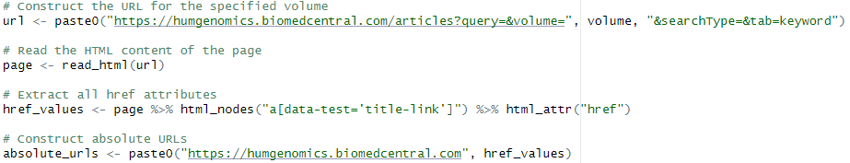
Scraping the Data Using R
By providing the Url and and getting the content in the url we can get all the data from that url as an web page/Html Page and converting it into a text and then reading it using read_html

Slide 7
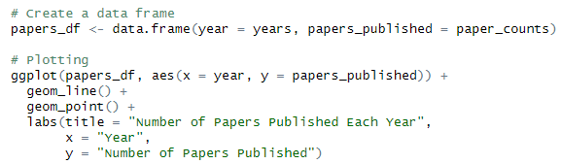
Data visualization,storing and analysis
First we are going to collect all the data and storing it to one data frame and then we are going to process it for the further use
Here we are getting all the data and storing it into the one Csv file in our local which is used to view and differentiate it easily in one sheet

Slide 8
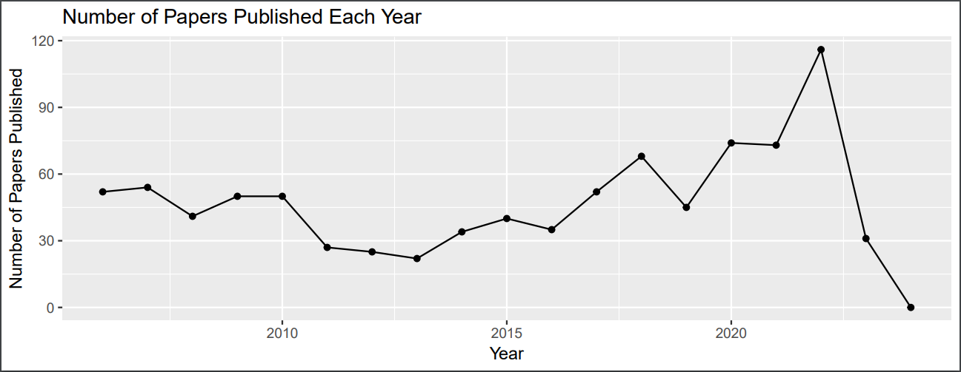
Plot Diagram (No_Papers_Published VS Year)

Slide 9
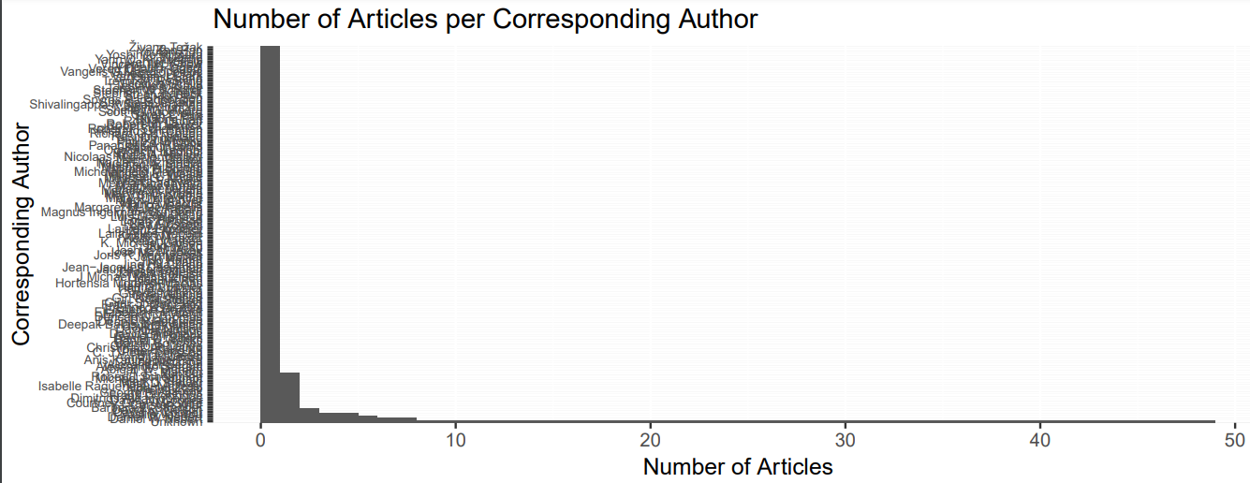
Plot Diagram (C_Author VS No_Articles)

Slide 10
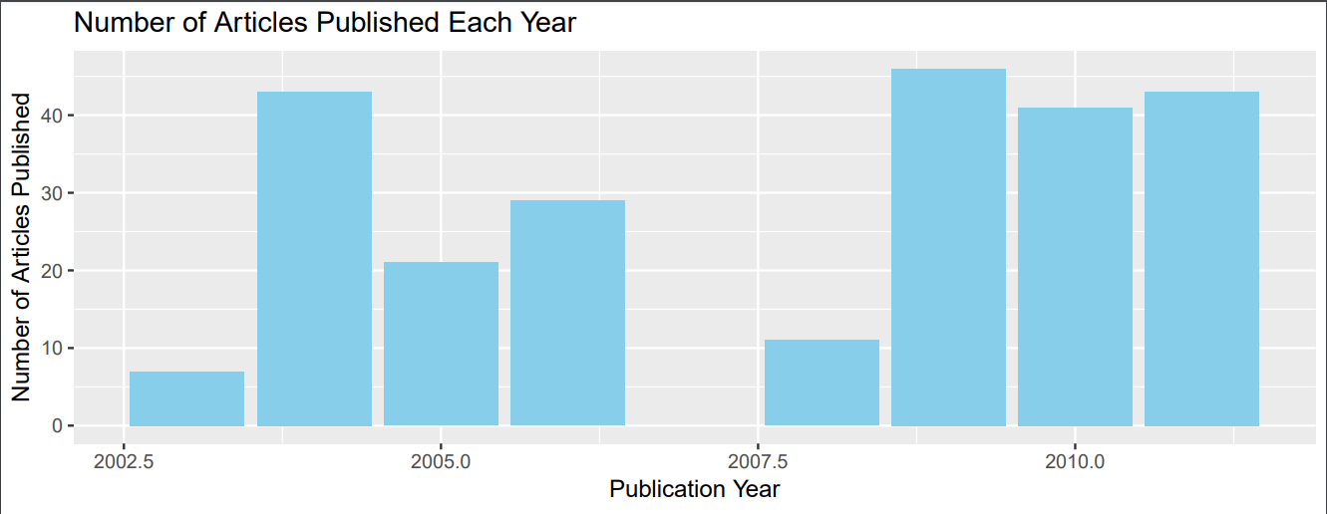
Plot Diagram (C_Author VS No_Articles)

Slide 11
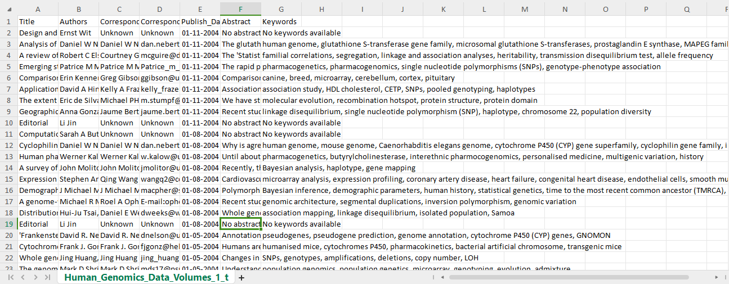
Data after extraction

Slide 12
Challenges Faced
We Have got many challenges while doing the project and now we are going to point some important challenges like:
During the web scraping we have faced issues in cleaning and getting the data in the particular fields.
While filtering the data and understand the statistics we got a large size bar graph so we again sorted it and brought the top prioritized data.
And some points we have seen no data so we need to initialize to “UNKNOWN”.
While extracting the data, we encountered Volumes 1 to 18 of articles, which significantly prolonged the runtime of our code (more than 10 minutes). Consequently, we have opted to reduce the scope to Volumes 1 through 5 to improve efficiency.

Slide 13
Conclusion
By this project we are able to scrap the data from on particular url and analyze it accordingly
And we are able to visualize the real time data upto date and we can relate it to the business needs
And we are able to see the importance of the web scraping and its usage in the real time business market

Slide 14
Contributions
Sai Nikhil Dunuka- Data cleaning and Visualization
Harshith Gade – Data Visualization and helped with web scraping
Gudisinti Durgaprasad-Web scraping
Most of the parts and documentation are done together.

Slide 15


